Slide 1

Analysis of Adverse Drug Effects Using Big Data and Cloud Computing
Leveraging data to enhance drug safety and protect patients
Notes:
Objective: To identify and analyze patterns in adverse drug reactions to support safer prescription practices and patient care.

Slide 2

Table of Contents
Objectives
Data Overview
Data Preprocessing
EDA
Machine Learning Models
Model performances
Conclusions

Slide 3
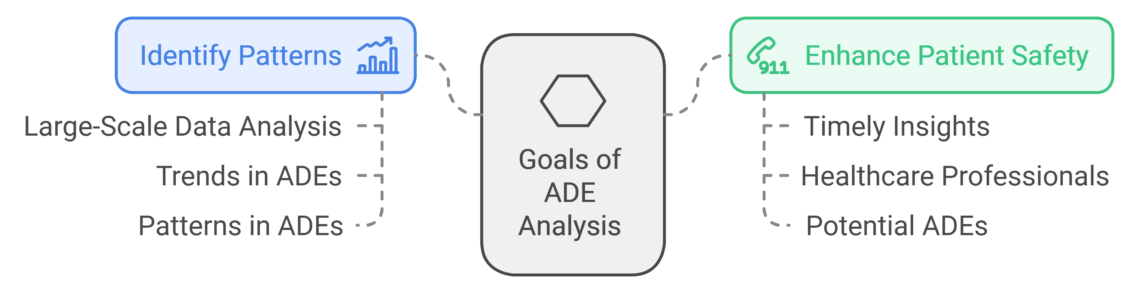
General description
Goal
Identify Patterns
Enhance Patient Safety:

Slide 4
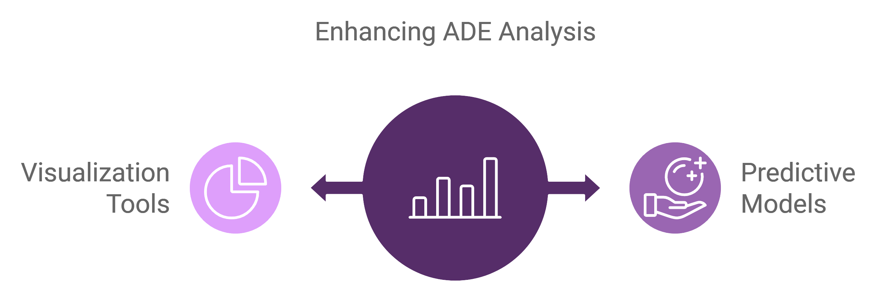
Objectives:
Data Integration: Integrate diverse data sources, such as electronic health records (EHRs), clinical trials, and patient reports, into a unified platform for comprehensive analysis.
Develop Predictive Models: Create and validate predictive models to forecast ADEs based on patient demographics, drug interactions, and historical data.
Create Visualization Tools: Develop visualization tools to help healthcare providers easily interpret data on ADEs and their impacts on patient outcomes.

Slide 5
Data Pipeline and Workflow
1. Data Collection - Import JSON files from FDA databases and store them in Google Cloud Storage.
3. Data Processing on Apache Spark - Utilize Spark on Google Cloud for scalable data processing and to handle the extensive size of the dataset.
4. Exploratory Data Analysis (EDA) - Analyze trends in adverse reactions by patient demographics, drug types, and dosage.
5. ML Classification Model Implementation.
5. Interpretation and Reporting - Document key findings and recommend safety measures based on observed patterns.

Slide 6

Dataset Overview & Collection Process
Source of Data: FDA Adverse Event Reporting System (FAERS).
Dataset Format and Structure: Initially in JSON format, containing structured fields that detail patient demographics, drug information, and reaction types. Unique reports are identified by safetyreportid, and each report includes patient data, reaction descriptions, and drug administration details.
Conversion to Parquet: Parsing JSON using Python to extract relevant columns and format them into Parquet for efficient analysis and compatibility with Apache Spark.

Slide 7
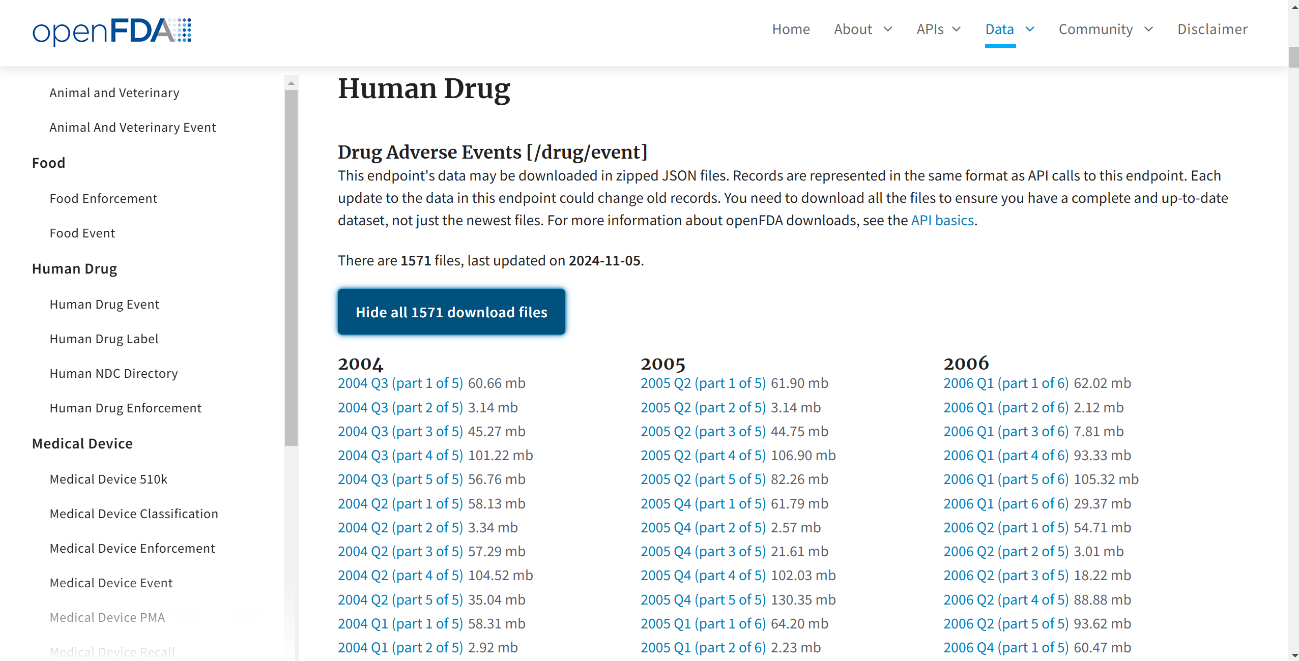
Replace this picture with cleaned dataset table

Slide 8
Data Preprocessing
Applied Data preprocessing steps in this slide
1. safetyreportid - Unique identifier for each report.
2. reactionmeddrapt - Type of adverse reaction (target column).
3. medicinalproduct - Name of the drug associated with the reaction.
4. patientsex and patientonsetage - Patient demographics to help identify any gender- or age-based patterns in reactions.
5. drugdosagetext - Information on the prescribed drug dosage.

Slide 9
EDA
Visualizations and stuff goes here

Slide 10
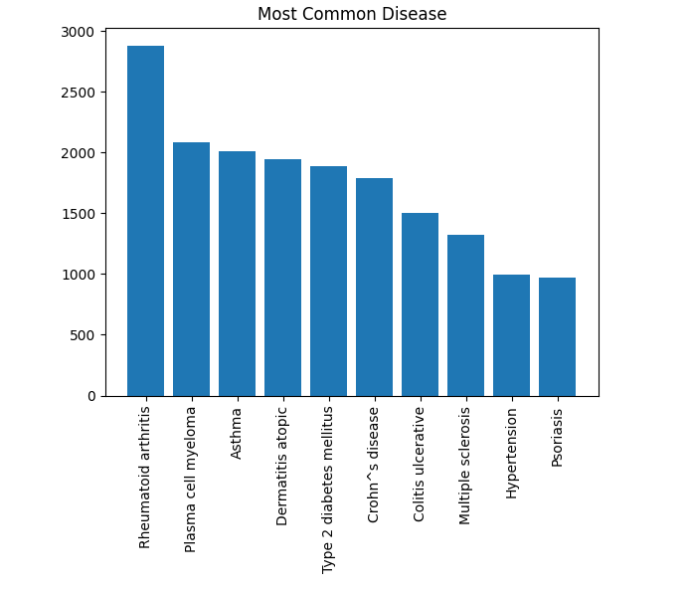
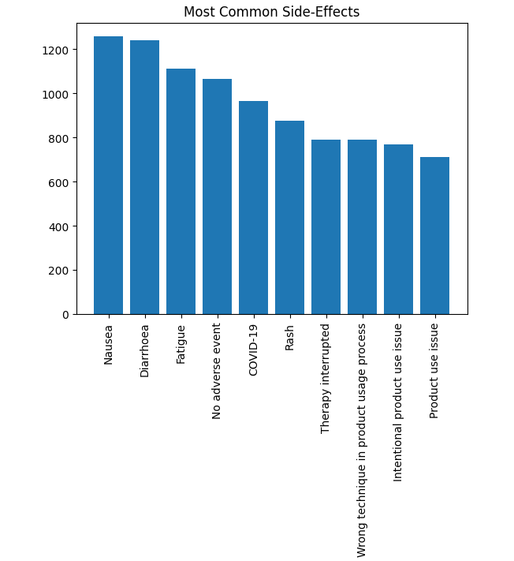
Data Visuals

Slide 11
Feature Engineering and ML Models

Slide 12
Model Results and Comparision

Slide 13

Conclusion and Key Takeaways
Summary of Key Points: Comprehensive ADR analysis using big data, cloud infrastructure, and scalable processing.
Identified crucial insights on drug safety to aid clinical decision-making.
Final Thought: This project demonstrates the power of data-driven insights in enhancing drug safety, with potential to save lives and reduce healthcare costs.

Slide 14
Thank you

